Slide 1



“Atfal Mafkoda”
Missing Children
Team Members
Sai Surya Varshith Nukala
Mahaveer Bonagiri
Gitika Jha (Team Representative)
Navya Jain

Slide 2



ABOUT THE CLIENT
Problem Statement
Reunites Missing People 3000+
2M+ Most Influential Initiative 2020
Cairo, Egypt
2015
The primary goal of this project is to design and implement an machine learning pipeline that effectively and efficiently identifies missing individuals within a large and diverse unspecified group of individuals.

Slide 3
Given Data
Organized Data
case['id']
case_code
Case_status
Post_id - can be multiple
post_url
post_text
post_time
photo_id - can be multiple
ocr_text
face_boxes
Preview_url
enhanced_id
original_face_box
enhanced_face
Signed_url
image_data/
│
├── missing_info.csv
│
└───[case_status]/
│
└───[case_id]/
│
├───photos/
│ └───……………..
├───enhanced/
│ ├───[case_id]_post_0_enhanced_0.png
│ ├───[case_id]_post_0_enhanced_1.png
│ └───...
│
├───photos_boxed/
│ └───……………..
└───enhanced_boxed/ │ └───……………..

Slide 4
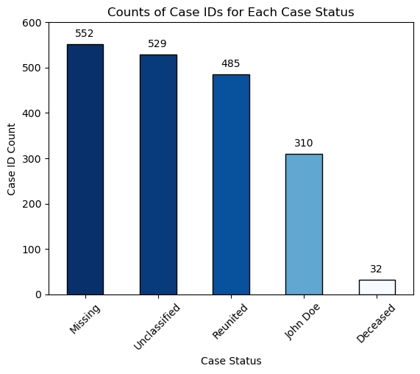
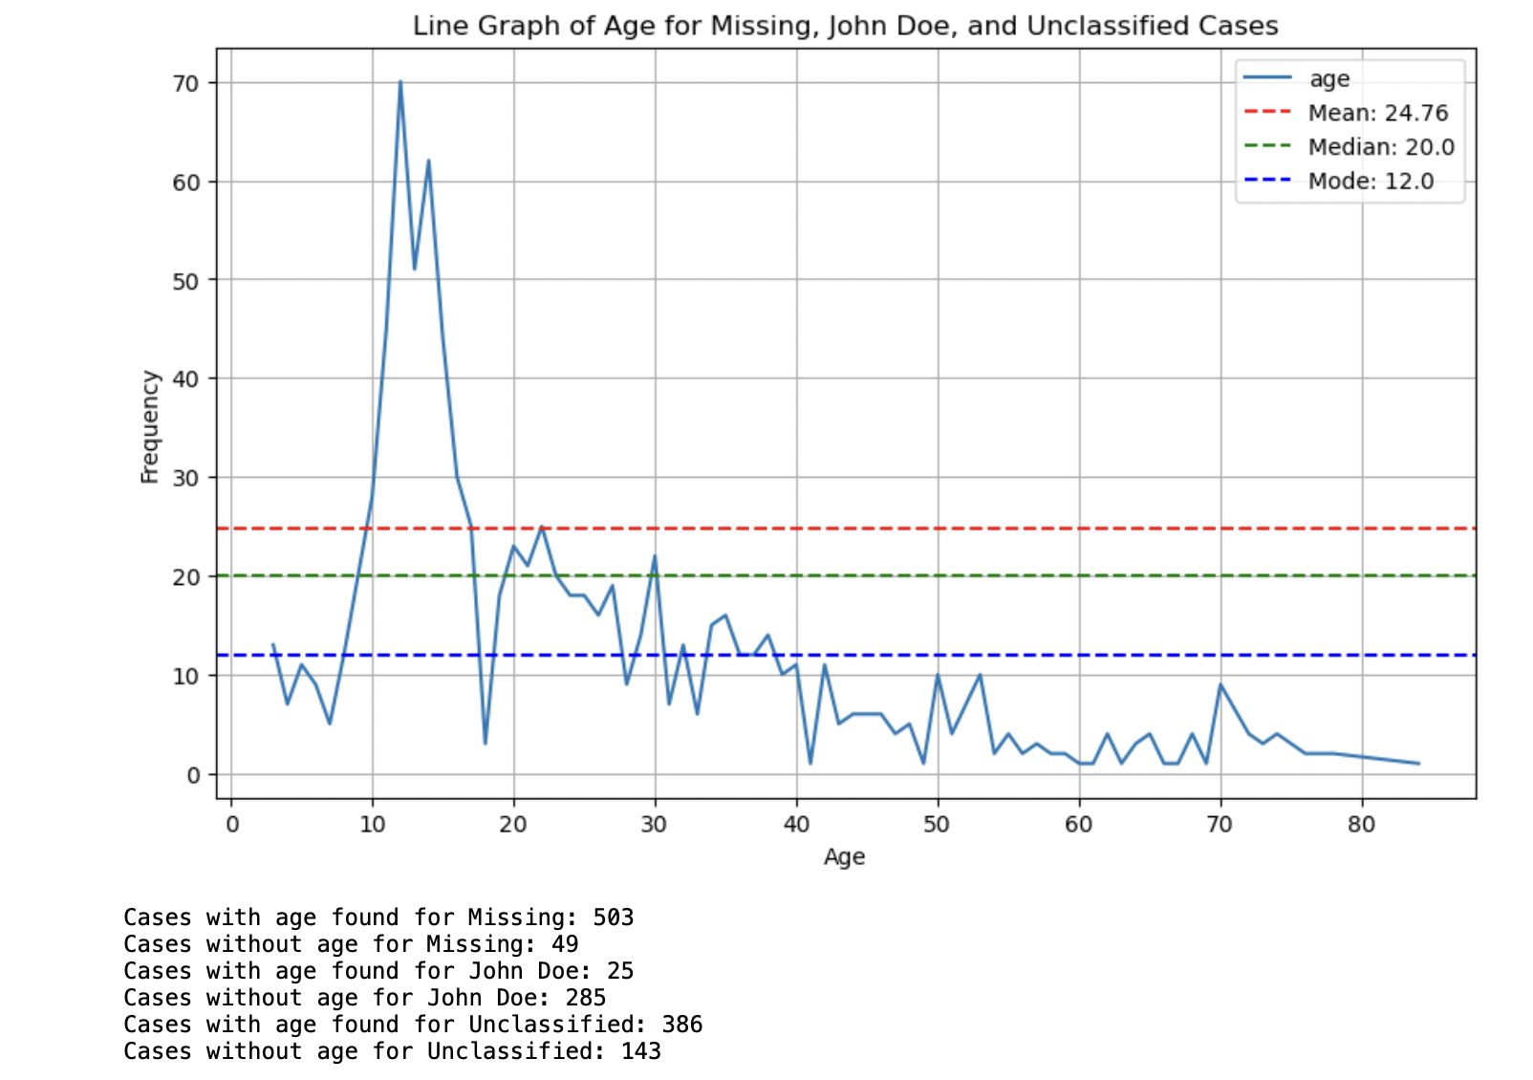
Data Exploration

Slide 5
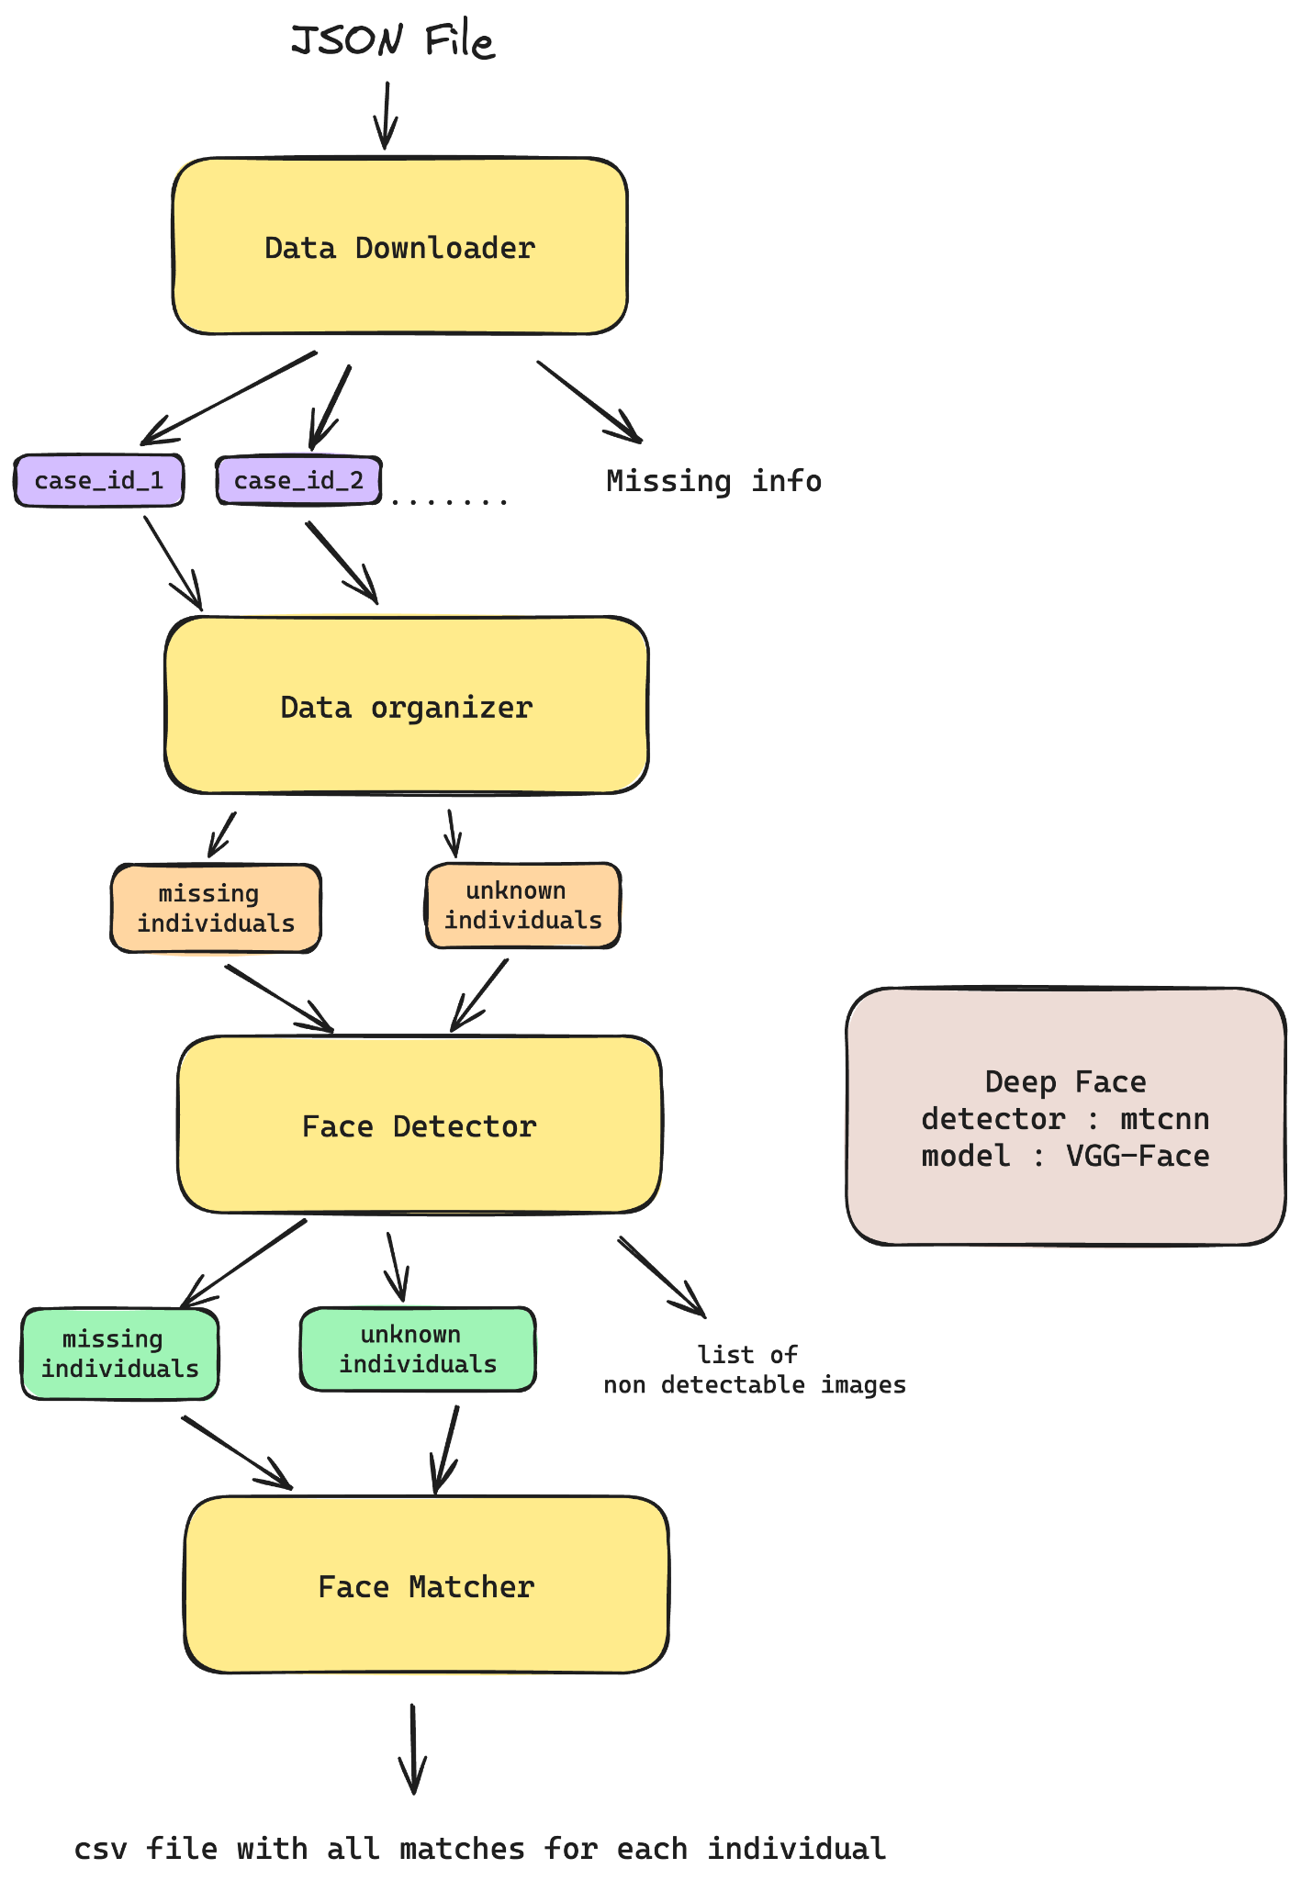
System Design

Slide 6
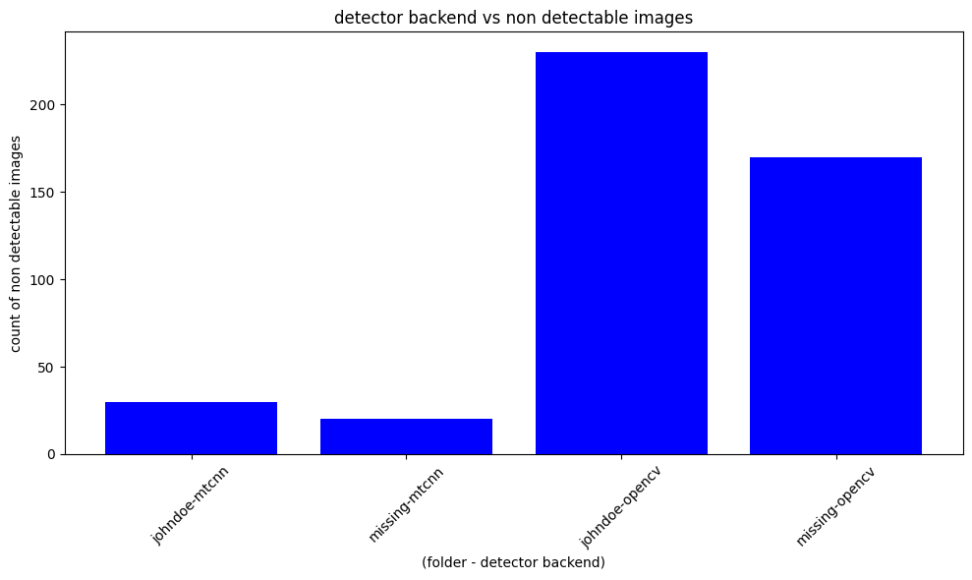
We used MTCNN backend detector. As we can see in the graph above, this choice resulted in a significant reduction of images being discarded, effectively maximizing the use of our dataset.

Slide 7
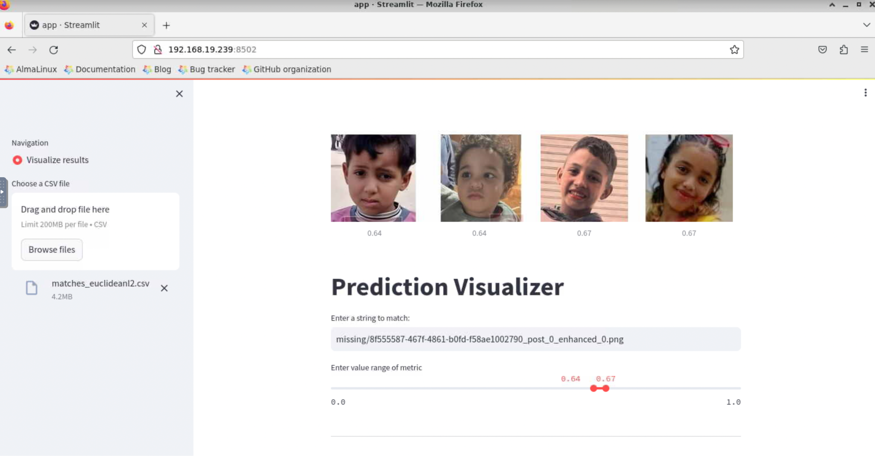

Slide 8
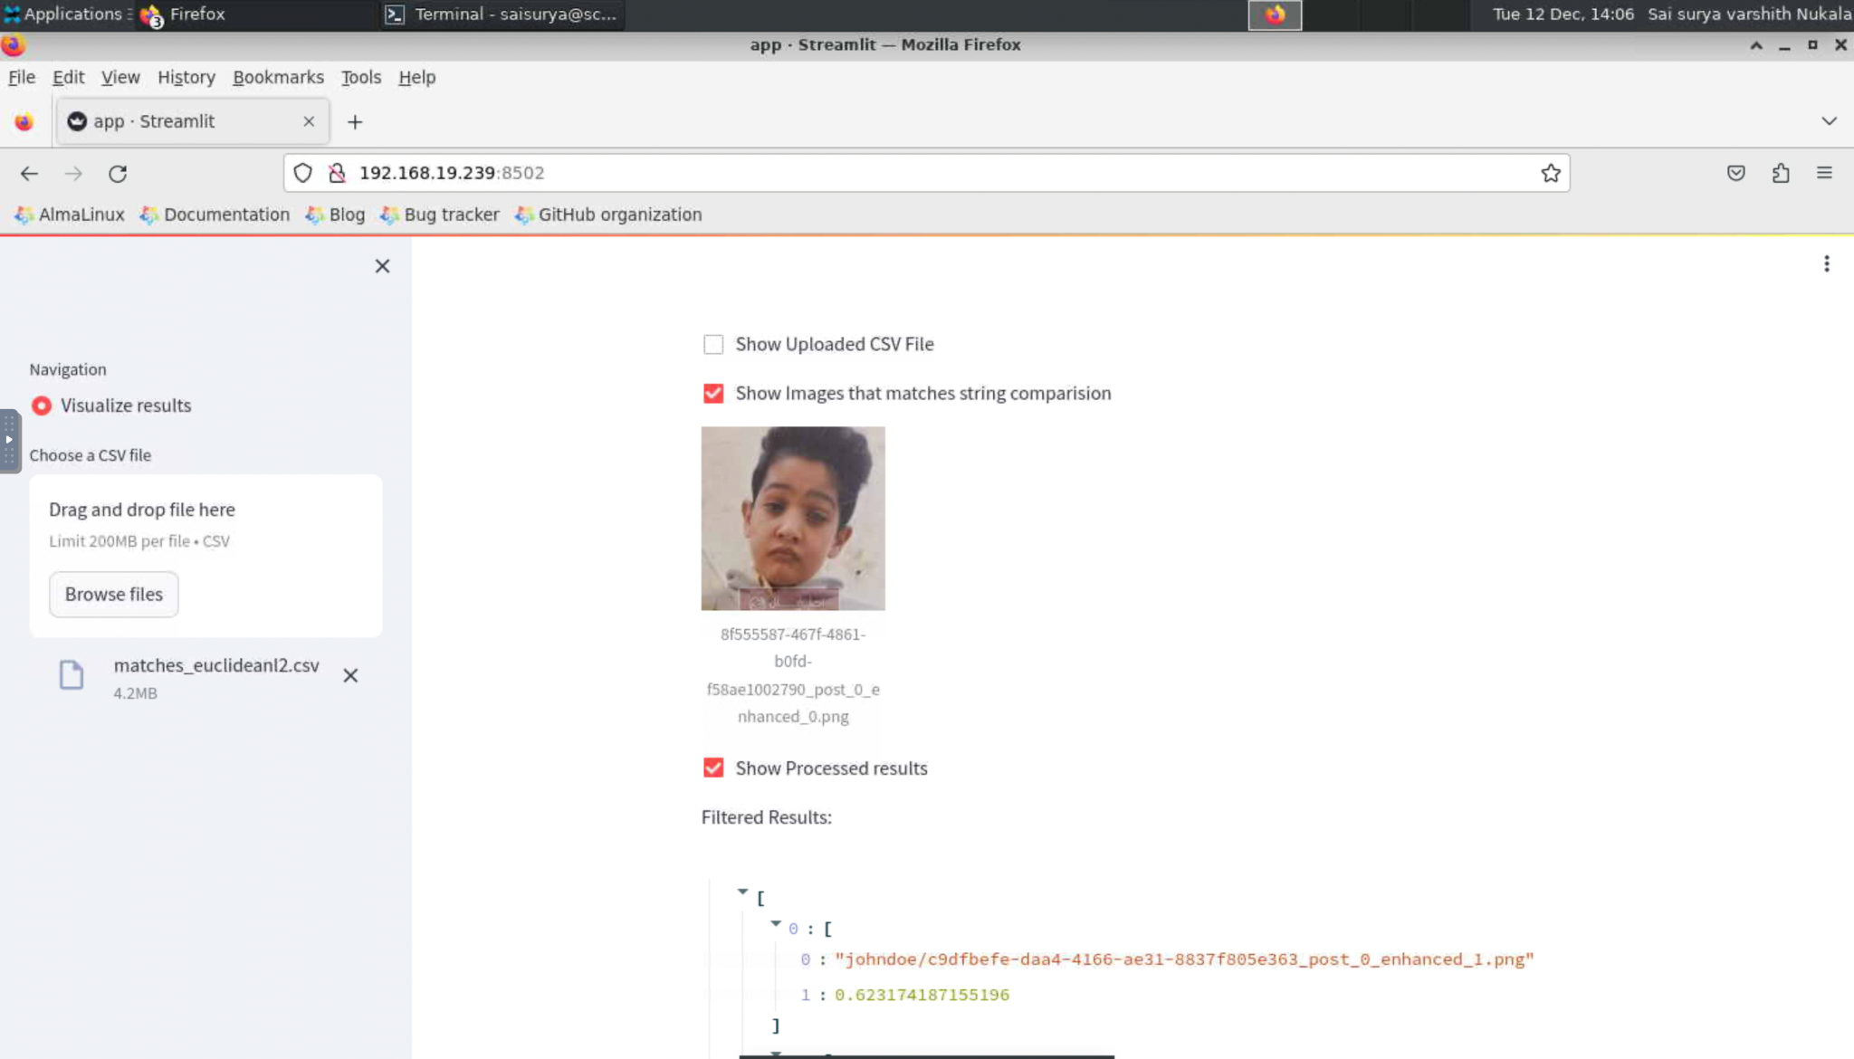

Slide 9
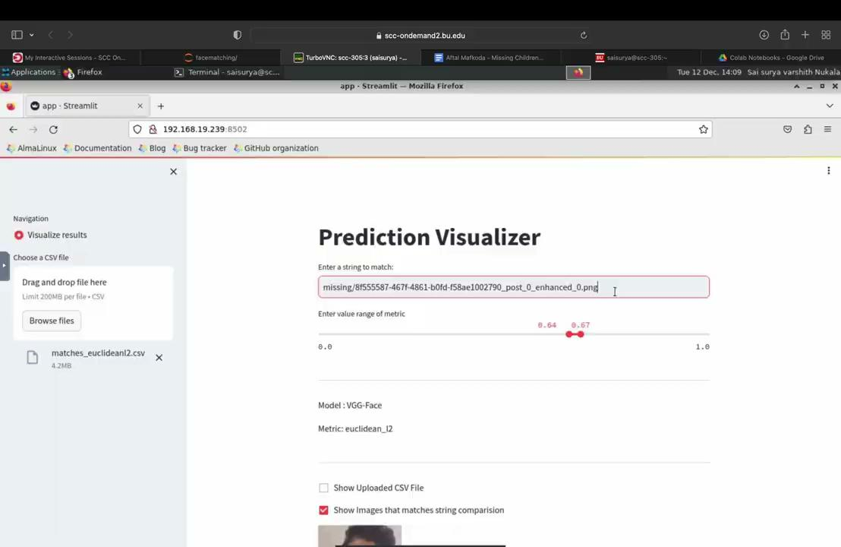

Slide 10
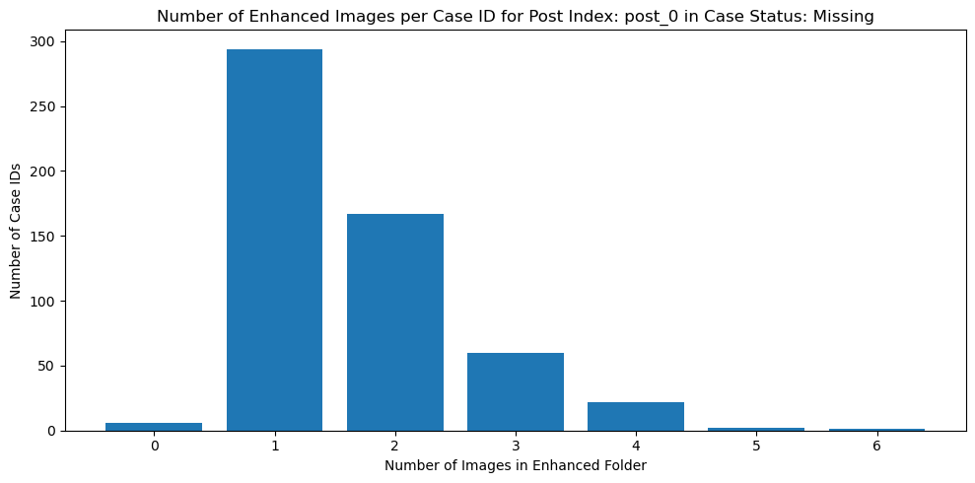
Performance Analysis
Experiment 1: Using Euclidean_l2 Metric
Directory for Missing Individuals: missing
Directory for Unknown Individuals: missing
Output File: matches_test_euclidianl2.csv
Model: VGG-Face
Metric: euclidean_l2
Detector Backend: mtcnn
Experiment 2: Using Cosine Metric
Directory for Missing Individuals: missing
Directory for Unknown Individuals: missing
Output File: matches_test_cosine.csv
Model: VGG-Face
Metric: cosine
Detector Backend: mtcnn

Slide 11
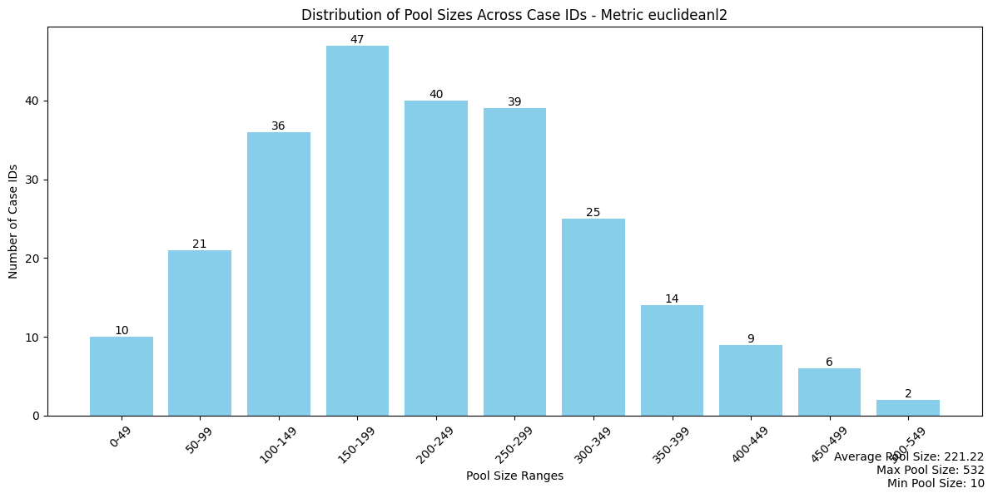
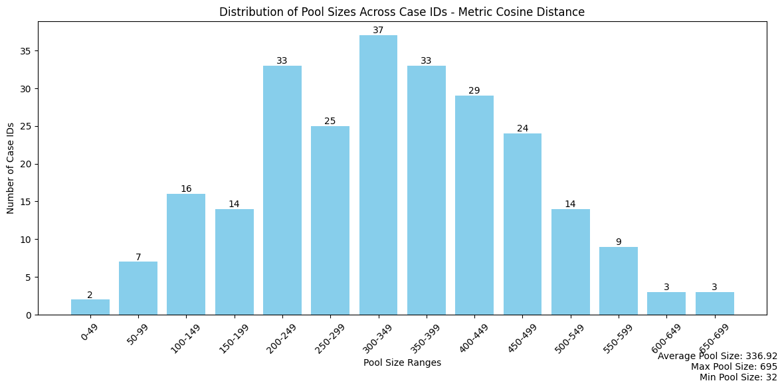
Pool Ranges
Avg Pool Size:- 221
Avg Pool Size:- 336

Slide 12
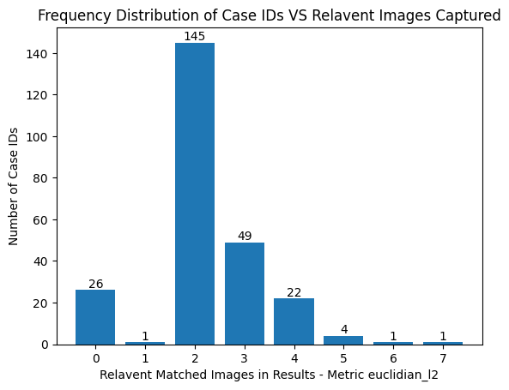
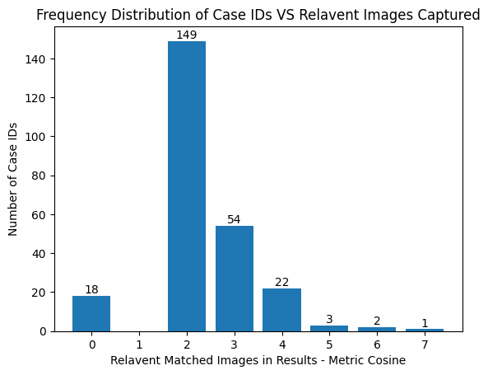
Relevant Matches

Slide 13
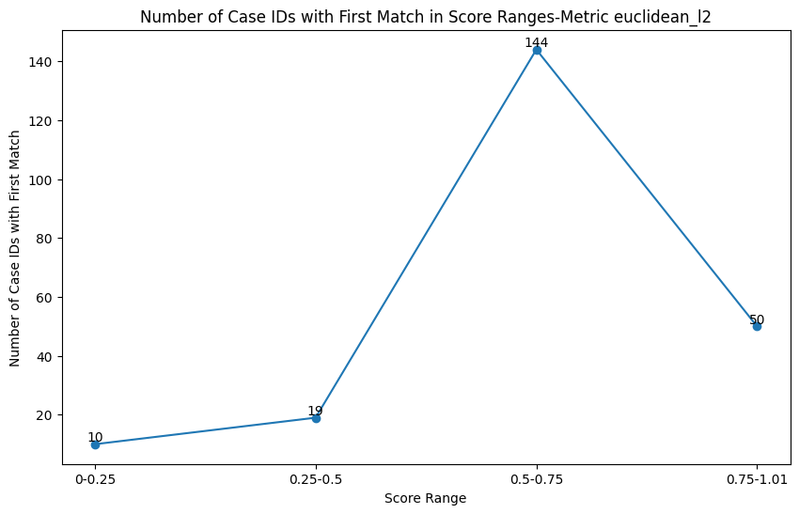
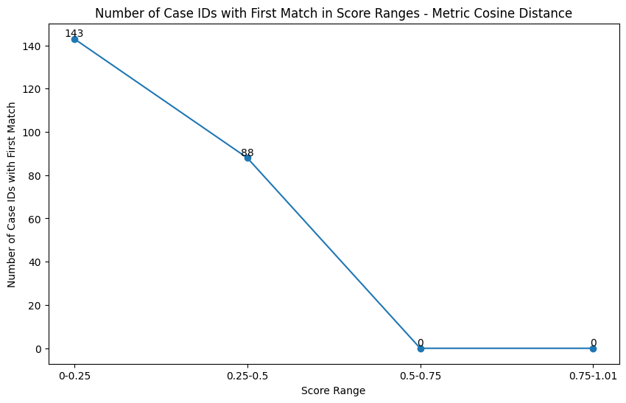
Metric Ranges Vs First Match

Slide 14
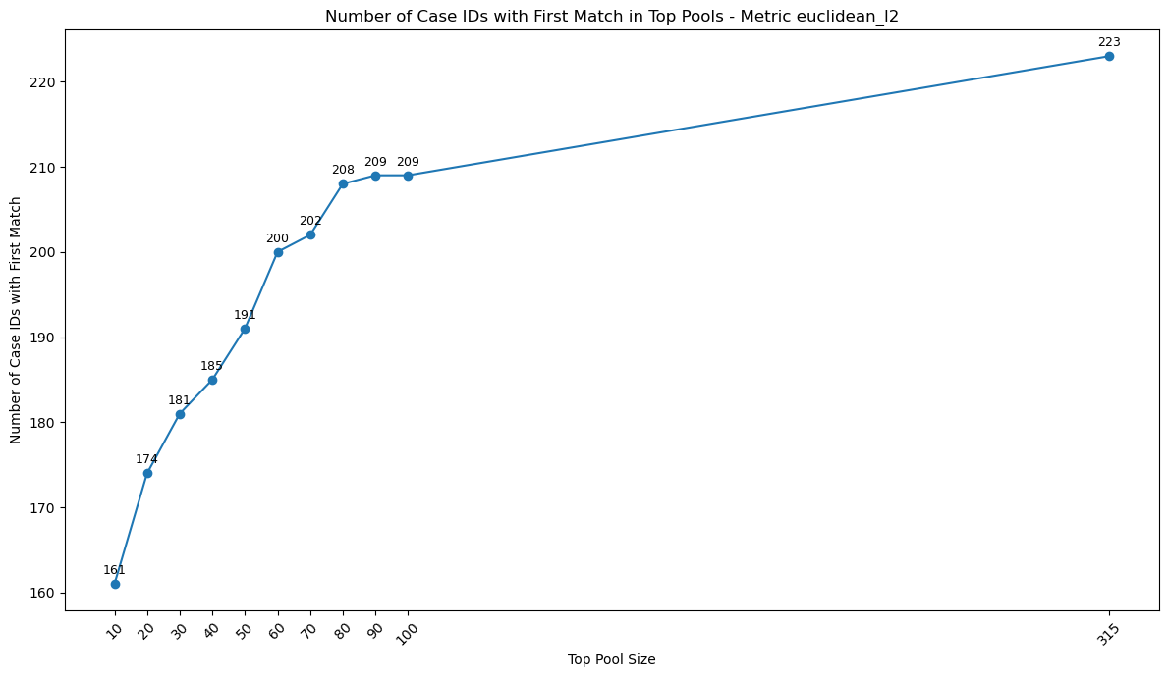
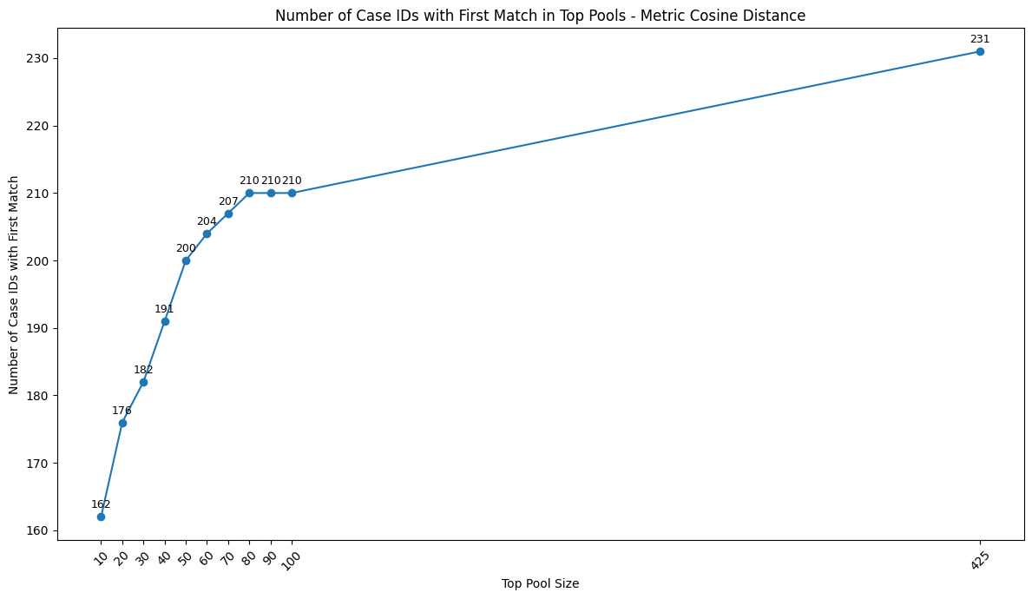
Top Pools Vs First Match
Number of Case IDs with at least one match in the Pool: 223
Number of Case IDs with at least one match in the Pool: 231

Slide 15
Distance Metric: euclidean_l2 Vs cosine
Criteria | Euclidean_l2 | Cosine
Total Case IDs Evaluated | 249 | 249
Case IDs with No Matches | 26 | 18
Case IDs with At Least One Match | 223 | 231
Avg Pool Size | Small (221) | Large (336)
Probability of Finding Exact Match | Good | Slightly Higher
Matches in Top 50 Pool | 85.7% (191/223) | 86.6% (200/231)

Slide 16
CONCLUSION
Utilized MTCNN backend detector for its high efficiency in detecting images and used VGG-Face Model to recognize the faces.
Evaluated performance using Euclidean_l2 and Cosine metrics, both showed similar effectiveness in identifying the first match in a sample dataset.
Developed and deployed a machine learning pipeline that effectively reduces the amount of photos a person needs to check in finding a missing individual.
The code was made modular and strictly follows class structure, providing scope for future improvements.
Technology Stack
Code: Python , DeepFace Module.
Deployment: Streamlit.

Slide 17
Thank you!
Questions?

